Slide 1
Chapter 1

Slide 2
Objectives

Slide 3
Objectives (cont.)

Slide 4
Four general-purpose programming languages

Slide 5
1990’s – Guido Van Rossum simple intuitive powerful The Python timeline

Slide 6
Syntax differences between Python and Java

Slide 7
Why Python is a great first language

Slide 8
Types of Python Applications

Slide 9
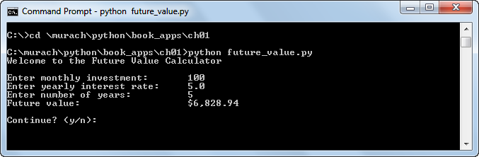
A console application

Slide 10
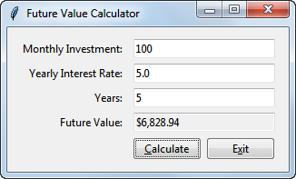
A GUI application

Slide 11
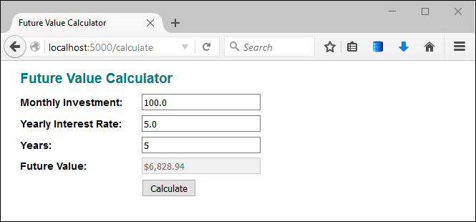
A web application

Slide 12
The source code for a console application

Slide 13
The source code for a console application (cont.)

Slide 14
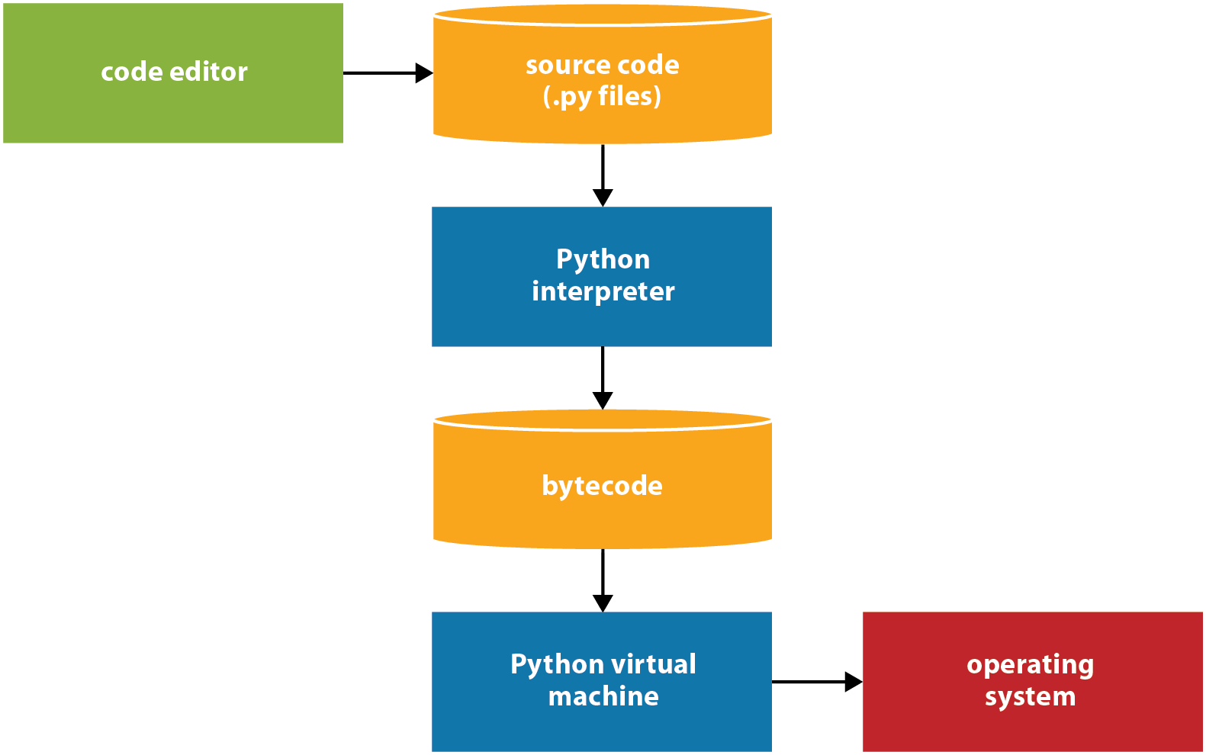
How Python compiles and runs source code

Slide 15
Procedure

Slide 16
Main memory and disk storage as an application runs

Slide 17
How disk storage and main memory work together

Slide 18
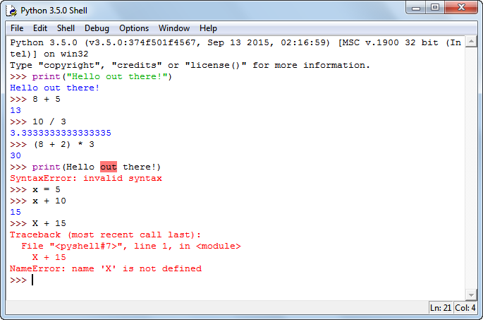
IDLE’s interactive shell

Slide 19
How to open, close, and restart the shell

Slide 20
How to use the interactive shell

Slide 21
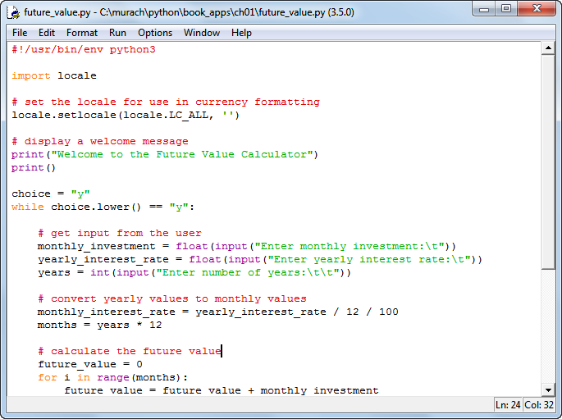
IDLE’s editor with a source file displayed

Slide 22
How to create, open, save, and close source files

Slide 23

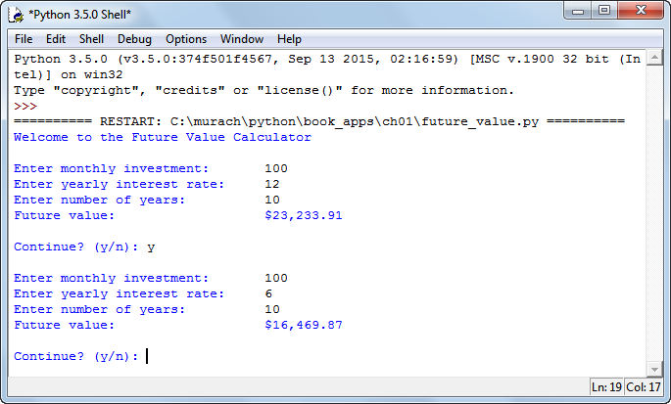
A console application that’s being run in the shell

Slide 24
How to compile and run a Python program

Slide 25
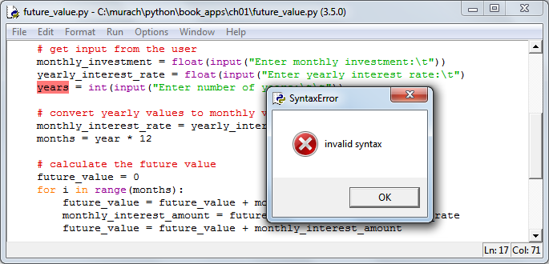
A dialog box for a syntax error

Slide 26
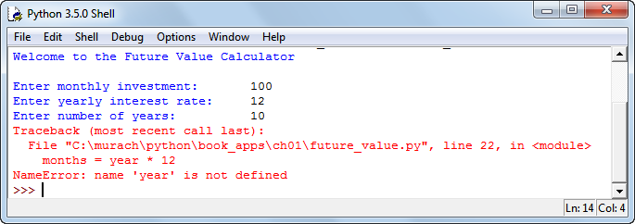
A message that’s displayed for a runtime error

